Slide 1
Quarterly report
Q3 – 2018
Australian Small Business and Family Enterprise Ombudsman

Slide 2
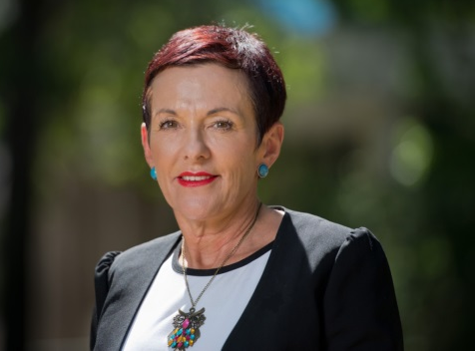
The third quarter saw the small business portfolio brought back into the Cabinet; and the opportunity of working closely with the new Minister responsible, Michaelia Cash. This, for us, signals the importance of the sector to Australia and its economy.
Our work on reforms to government payment times paid off with the addition of a new contract clause to the Department of Finance’s ‘clausebank’ for government contracts. Where a contract with a prime subcontractor states payment terms of 30 day or less, the same terms are to be included in the contracts of every subcontractor attached to the job. We urge all government agencies to use this clause in their contracts.
We released a series of Fast Facts to provide advice to small businesses on managing energy usage, resolving disputes, getting ready for the NBN, how to be safe online, and calling out unfair contract terms.
The quarter ended with the release of the Banking Royal Commission interim report. We were pleased Commissioner Haynes supported our view the small business definition of a loan facility in the Code of Banking Practice should be $5 million; not the current $3 million.
Key activities
Major media appearances: The Drum, Sky Business News, From the Trenches (Accounting Industry) podcast, Business Essentials audio magazine, Australian Brokers, Small Business Mental Health podcast series, SBS Small Business Secrets, Andrew Bolt (Sky News), Ross Greenwood program
Media topics: energy pricing, illegal phoenixing, payment times, workplace relations, ABA Code of Banking Practice, automotive industry code, fintech lending, access to capital, Banking Royal Commission
Events: the Ombudsman participated in 34 events across the country as keynote, panellist and guest speaker
OUTREACH
However, we are disappointed the Commission did not appear to appreciate the lack of power small businesses have when dealing with banks or the impact when a bank decides to exit a sector or region and revalues loans, creating defaults, making it difficult for SMEs to access alternate finance. We also believe small business witnesses were not sufficiently supported to prepare and present their cases.
ASBFEO has requested Commissioner Hayne extend the timeframe of the Royal Commission and hold a further session to hear from more small businesses. In doing so, allow adequate time for and provide financial support to small business witnesses to engage expert legal representation to prepare and present their case on equal footing with the legal experts that represent the well-resourced banks.
Commenced a submission to the Royal Commission on the banking, superannuation and financial services industry interim report
Published an SME guide to borrowing from fintech lenders
Completed an analysis of deemed statutory trusts in the building and construction industry
Continued work to simplify the usability of the Personal Properties Security register
Drafted operational framework of a Business Growth Fund to deliver access to capital for high growth potential SMEs
ADVOCACY
Received 1053 contacts – 21% increase on Q3 2017
80% requested assistance to resolve a dispute
The main issues of concern related to payments (33%), general dispute resolution (27%) and issues such as online business reviews, inconsistent charging regimes, online marketing services and product returns and contracts (23%)
The majority (89%) of contacts were business to business issues
ASSISTANCE
Kate Carnell AO Australian Small Business and Family Enterprise Ombudsman
2

Slide 3
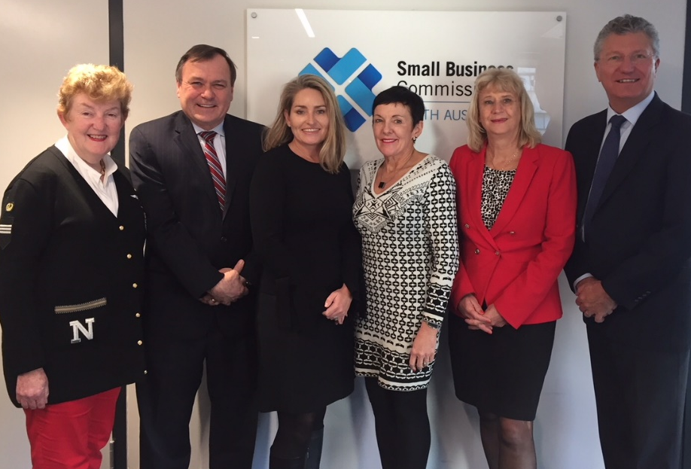
Outreach: communications and stakeholder engagement
Representing small business issues and interests, the Ombudsman attended 35 meetings with government and met with 42 key external stakeholders.
The Ombudsman participated in 47 media interviews and over than 253 media mentions (radio, TV, print and online).
Five videos were developed and published online (see Media).
Five small business success stories were developed and published on the ASBFEO website (see Resources) and six business dispute case studies (see Assistance).
ASBFEO promoted small business in campaigns: NAIDOC Week, Small Business Festival Victoria, R U OK? Day and National Family Business Day.
The Small Business Media-Communications Network participated in two teleconferences to discuss issues and mutual opportunities (members from ATO, FWO, business.gov.au, DIIR, ACCI, Small Business Commission in NSW, Victoria, WA, SA and Qld, Family Business Australia).
An analysis of social media campaigns has been completed and recommendations for future campaigns compiled.
Meeting with Small Business Commissioners
From left: Robyn Hobbs NSW Small Business Commissioner,
John Chapman SA Small Business Commissioner, Maree Adshead Qld Small Business Champion, Kate Carnell, Judy O'Connell Vic Small Business Commissioner, David Eaton WA Small Business Commissioner
Traditional and social media
2,599 subscribers
More than 253
mentions
31 media releases
9.2% increase in page views
Dispute support most visited page
7.6% increase in followers
5 videos published
11% increase in followers
36% increase in engagement
193 new
connections
3

Slide 4
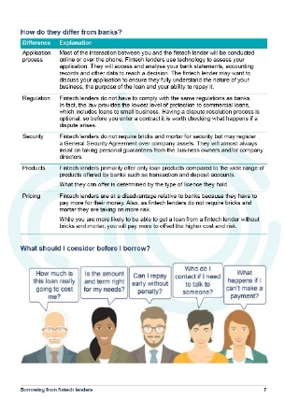
Advocacy: a voice on policy and legislation
Royal Commission
Fintechs
The Royal Commission into the Misconduct in the Banking, Superannuation and Financial Services Industry will further impact SMEs seeking to access finance to start and grow their business, both in terms of access and cost.
The ASBFEO will work on potential policy solutions that aim to provide adequate protection for small business borrowers. This includes:
a simple definition of small business loan facility to include loans less than $5 million
strengthening the Code of Banking Practice, the primary protection for small business owners, to ensure it is enforceable
ensuring unfair contract terms legislation is effective across the financial services industry
ensuring ASIC’s enforcement and penalty provisions are effective and sufficient to deter future breaches
monitoring the commencement of the Australian Financial Complaints Authority to ensure improved outcomes for small business
We will provide a submission to the interim report and also hope to participate in the seventh round of public hearings, scheduled for mid-November, which will focus on policy responses.
We published the guide, Borrowing from fintech lenders, to support small business make an informed choice when borrowing from online lenders, and how fintechs compare to more traditional lending. The guide is a joint initiative of ASBFEO and theBankDoctor.org.
Visit asbfeo.gov.au/resources/finance
The fintech industry released a Code of Lending Practice, with six online small business lenders signing the code. An independent Code Compliance Committee (CCC) will be appointed to oversee compliance with the Code. It is expected that signatories be compliant and the CCC in place by 31 December 2018.
Business Growth Fund
Following consultation with APRA, the Reserve Bank of Australia, and the financial services sector, a paper detailing the Business Growth Fund has been finalised. This looks at the operational framework for creating a single commercial entity, to provide access to patient capital for high-growth SMEs.
4

Slide 5
Advocacy: a voice on policy and legislation
Personal Property Security Register
Payment times
Ombudsman Kate Carnell is one of four independent panellists, chaired by Graeme Samuel AC, who will review the Business Council of Australia’s (BCA) Australian Supplier Payment Code. They will assess if the code is fit-for-purpose and is improving payment times and practices – particularly for small business suppliers.
As part of our inquiry into Affordable Capital for SME Growth, we made a recommendation to improve the usability of the Personal Property Security Register (PPSR).
This register represents an important opportunity for small business to secure assets from insolvent clients and to assist fund raising by using assets as security.
Currently, the benefits and risks of the register are not well known to SMEs.
When the register is used it requires a level of knowledge and accuracy that makes many registrations invalid.
We are facilitating conversations with industry and government to simplify using the register.
www.ppsr.com.au
The SME Growth Index¹ reveals cash flow continues to be the primary concern for SMEs. Improved cash flow and payment times could generate, on average, 17% more revenue – or a $A234.6 billion contribution to the national economy.
With 89% of SMEs investing personal funds to grow their business, and banks reluctant to lend, a lack of credit could result in a major downward trend in the economy.
1. Scottish Pacific Business Finance, SME Growth Index, September 2018, www.scottishpacific.com
Deemed statutory trusts
To ensure subcontractors in the construction industry are paid, we analysed the costs and benefits of implementing cascading deemed statutory trusts in the construction industry, and on balance support their implementation. The benefits include:
Confidence of a reliable and sustained cash flow as payments due are quarantined in the trust fund.
An incentive for speedy payment by the contractor higher up the chain. They only draw their profit from the trust when payments due to subcontractors are made.
Bookkeeping practices required to keep a trust which will assist small businesses to properly understand their financial situation, thus addressing key causes of insolvency in the industry.
5

Slide 6
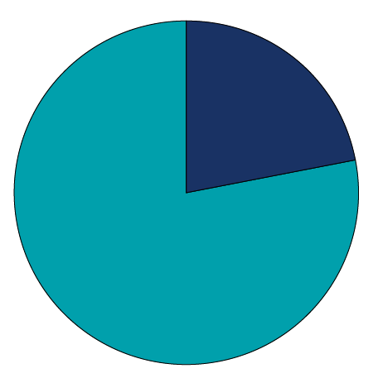
Advocacy: a voice on policy and legislation
Digital economy
Access to Justice inquiry survey
ASBFEO continues to promote the benefits of the digital economy to SMEs. In particular, we continue to work with small business industry associations to seek and promote the benefits of digitisation and the NBN.
As a member of the Business Digital Council, ASBFEO continues to advocate the benefits of e-invoicing, which includes saving time and money to enhance business growth.
A number of industry reports also add weight to the advantages of digital take-up. These include the Xero Small Business Insights Report and the 2018 Telstra SB Intelligence report.
Xero found that in mature NBN areas there is more positive growth for SMEs than in less mature NBN areas, or non-NBN areas. Also, small businesses that use accounting software and business apps are more likely to grow.
Telstra found 62% of customers will not consider a small business if they cannot find it online and 50% of businesses do not have a website.
Of the 1600 Australian businesses surveyed:
22% experienced a dispute in the last five years and sought external help
biggest cause of dispute was payments (44%) – full amount not paid (26%), not paid on time (18%)
66% first sought help from a lawyer or legal service
of those who commenced formal proceedings, 13% abandoned the process with the majority (49%) saying costs outweighed the potential gain
$130,173 was the average cost to pursue a dispute
younger business more likely to abandon a dispute
Changing landscape in SME tax
Capital gains tax concessions – we propose changes to provide access for businesses with a turnover figure of $10 million or less
Instant asset write off – we support the extension for another year but seek the threshold to be raised to $100,000. The cost to Government can be mitigated if small business can claim up to $100k every 4–5 years.
ATO’s annual report – we applaud the ATO pilot to offer small businesses an independent, internal review and it should be extended to all small businesses. We support the call for a Second Commissioner to head up a separate and dedicated appeals group to ensure an independent review.
22%
22% of businesses experienced a dispute in the last five years
6

Slide 7
Advocacy: a voice on policy and legislation
Submissions
ASBFEO Policy Forum
We completed 31 submissions this quarter, which included:
The Ombudsman held the second webinar for the forum with thirty-seven representatives from across industry associations participating. They represented a range of industries including food and grocery, restaurants and catering, independent contractors and the law council.
The main issues explored were simplifying workplace relations, access to capital, instant asset write-off, regulation of payment times, combined PAYG and super payment to the ATO, Unfair Contract Terms and government procurement.
supporting initiatives to reform corporate misuse of insolvency laws and reforms to combat phoenixing activities
supporting moves toward disqualifying directors who use these ‘sharp practices’
recommending changes to the regulation of gift cards, including the introduction of a minimum three-year expiry period
opposing the introduction of punitive penalties for PAYG and Super Guarantee compliance oversights
supporting modernisation of business registers (such as ASIC Company data registers) and implementation of a single portal for business owners
supporting the extension of unfair contract terms to apply to insurance contracts
opposing proposed changes to Intellectual Property laws that increase complexity and further disadvantage small businesses
supporting the introduction of Consumer Data Rights, which will allow consumers and small businesses to better control their own data
advocating for greater consideration of small business’ needs in relation to the proposed Trans-Pacific Partnership
supporting simplification and protection of intellectual property rights, including changes to implement rapid and affordable dispute resolution to enable small business to protect their rights
making representations to ACCC enquiries regarding procurement practices in the waste sector in South Australia.
Working groups
Seven working groups met during the quarter:
Contracting and UCT
Digitalisation and the NBN
Energy Cost
Access to Justice
Key issues raised included:
Cyber Security
Human Capital
Workplace Relations Simplification
energy costs and challenges with the ACCC report
temporary skill shortages
enterprise Bargaining Agreements
Fast facts
Five fast fact sheets were published to the website to provide support to small business on key topics.
7

Slide 8
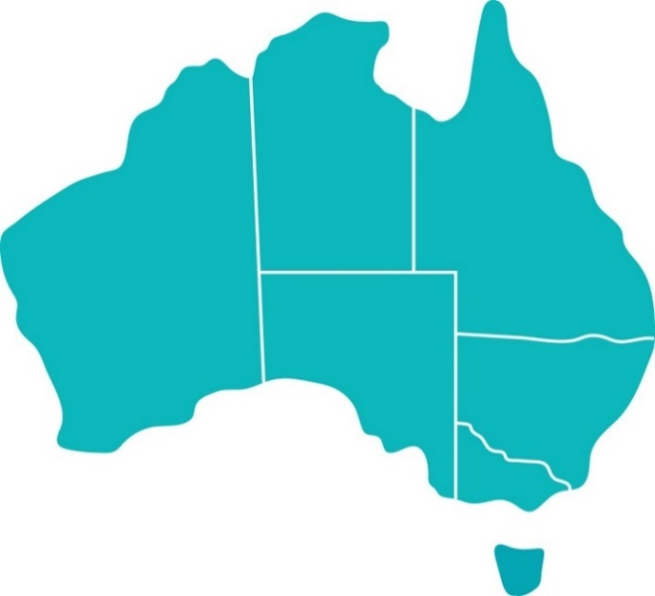
Assistance: support for SMEs
1,053 contacts received via phone, email and web inquiry. Of these, 354 were made direct to ASBFEO while 699 were via the Infoline.
Resolution pathways
Refer to …
39%
17%
851 were requests for assistance with resolving disputes. 83% of contacts came from small business owners, family enterprises and sole traders.
Resolved by ASBFEO – 44%
37%
4%
OR
2%
1%
The majority of the direct contacts were business to business disputes
2%
32%
89%
8%
9%
8%
of disputes were business to business
of disputes were business to government
24%
18%
17%
6%
Contacts by state/territory were similar to last quarter.
2%
8

Slide 9
Next steps
Campaign participation: Mental Health Week, World Mental Health Day, Stay Smart Online Week, NT Business Month and Financial Capability Week
Ombudsman participation in external events to promote the office and its role and services (currently 16 events booked next quarter)
Marketing: engagement and liaison with industry associations
Launch of online booking tool for the Small Business Hub
OUTREACH
Stay Smart Online Week
8–14 October
Publish Access to Justice Inquiry Report Phase 1 survey results and recommendations for Phase 2
Compile a submission for the Treasury review of the Unfair Contracts Terms legislation commencing in November 2018. In particular, making UCT terms illegal and increasing regulator powers and penalties
Publish the research paper on the costs associated with deemed statutory trusts in the building and construction sector, including a recommendation for deemed statutory in federal government procurement
ADVOCACY
Unfair Contracts Terms legislation
Continue working on emerging matters affecting small business, such as the impact of predatory behaviour in the office technology leasing/finance industry and the impact of Government stepping into the Green Bin industry in ACT
Continue working with other agencies such as Small Business Commissioners and Fair Trading to streamline processes so small business can quickly and efficiently access assistance from the most appropriate agency
Continue to work with the Commonwealth Department of Public Prosecutions to streamline the process by which ASBFEO can treat non-compliance for requests to provide information under our legislation
ASSISTANCE
Streamlining processes so small business can quickly and efficiently access support
9

Slide 10
Copyright notice
http://creativecommons.org/licenses/by/3.0/au/
With the exception of coats of arms, logos, emblems, images, other third-party material or devices protected by a trademark, this content is licensed under the Creative Commons Australia Attribution 3.0 Licence.
We request attribution as © Commonwealth of Australia (Australian Small Business and Family Enterprise Ombudsman) 2018.
All other rights are reserved.
Icons in this document were used under a Creative Commons license from the Noun Project (http://thenounproject.com). Permission may need to be obtained from third parties to re-use their material.
Written enquiries may be sent to:
Manager Media and Communications Australian Small Business and Family Enterprise Ombudsman 02 6121 5218 media@asbfeo.gov.au
10

Slide 11
Canberra
Level 2
15 Moore Street
Canberra ACT
Sydney
Level 9
255 Elizabeth Street
Sydney NSW 2000
GPO Box 1791
Canberra City ACT 2601
T 1300 650 460 E info@asbfeo.gov.au
Twitter : @ASBFEO
Facebook: @ASBFEO
LinkedIn: Australian Small Business and Family Enterprise Ombudsman
YouTube : Australian Small Business and Family Enterprise Ombudsman
Other useful contacts
NSW Small Business Commissioner
T 1300 795 534 E we.assist@smallbusiness.nsw.gov.au
SA Small Business Commissioner
T 1800 072 722
E sasbc@sa.gov.au
VIC Small Business Commissioner
T 138 722
E enquiries@vsbc.vic.gov.au
WA Small Business Commissioner
T 131 249
E info@smallbusiness.wa.gov.au
Australian Competition and Consumer Commission
T 1300 302 021 W www.accc.gov.au
Fair Work Ombudsman
T 1300 799 675 W www.fairwork.gov.au
Australian Securities and Investment Commission
T 1300 300 630 W www.asic.gov.au
Australian Taxation Office
T 13 72 26 W www.ato.gov.au

